Slide 1
Internet of Things
Presented by :-
Vidhi Patel (CWID: 893375105)
Piyusha Zanjad (CWID: 893578021)

Slide 2
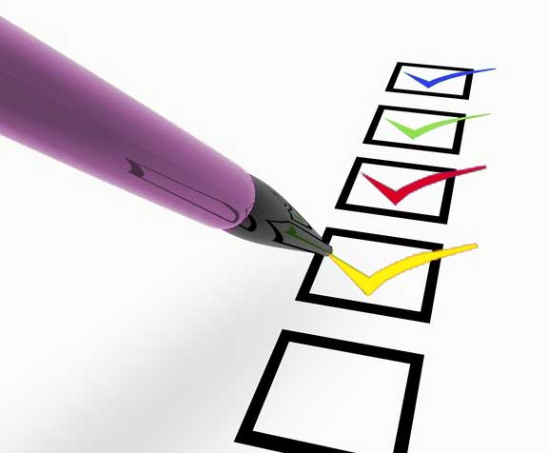
Agenda
What is Internet of Things (IoT)
Major promoters of IoT
Open source projects promoting IoT
Group’s thoughts on IoT

Slide 3
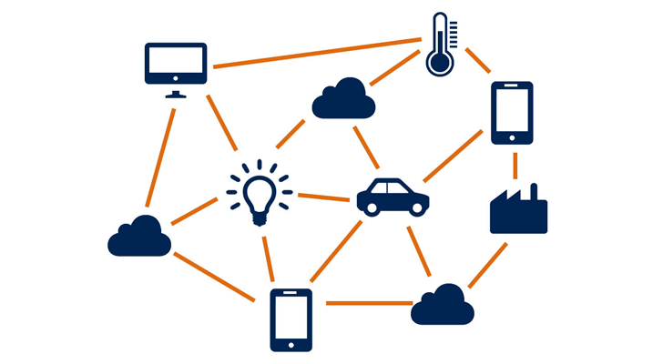
What is Internet of Things?
Internet of things can be defined as the connection between devices to exchange data over the internet without any human intervention.
It can also be described as a network of physical objects which refers to connecting an object with people, systems or with another object.

Slide 4
IoT continued…
With the use of IoT
We can collect data for keeping count and track of everything which will help us to know , when things will need repairing , replacement or recalling and whether they were fresh or past their best.
No human intervention is needed, saving the time and cost.

Slide 5
Major promoters of IoT

Slide 6
Open source projects promoting IoT
There are various open source projects for IoT, some of the best innovations are :-
FARMBOT GENESIS - Open Source CNC Farming Machine
MYCROFT - Open software to process natural language, determine your intent and take action.

Slide 7
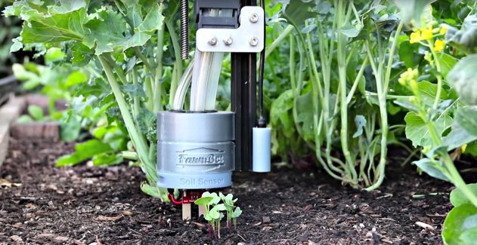

FarmBot
FarmBot is a Genesis tool which helps in Farming by moving around the xyz space 24 * 7, growing food for you you just the way you want it to be grown.
It can be controlled and configured with any device
It allows drag and drop farming
Growing Regimens
Custom Sequences
Real Time Control

Slide 8
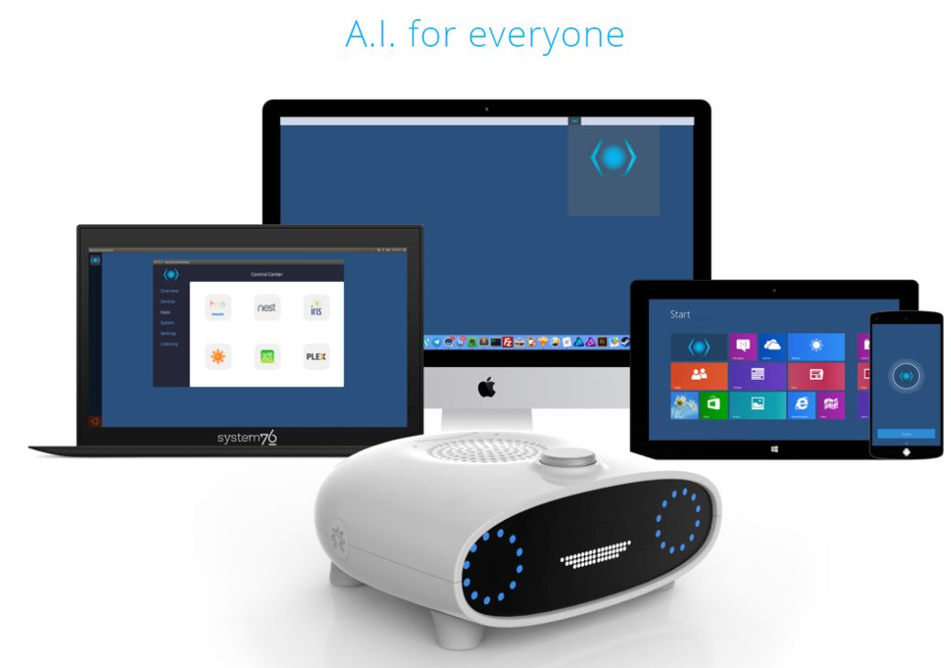
MyCroft
MyCroft is based on the Artificial Intelligence for the Whole Home. It connects to the Wifi and it is affordable that you can have one in each room.
MyCroft helps you to play music, lock a door, check the wheather or talk to another room, etc
It is an open source, open hardware product based on Raspberry Pi 2.
It is can be used for the office, for the maker and for the home.

Slide 9
Group’s thoughts on IoT
Advantages : -
Helps us in making better decision as it has lots of information.
It also helps us in keeping track of the things for example whether the milk is in stock or out of stock.
It does not need human intervention at all and hence lots of time and money is saved.

Slide 10
Group’s thoughts on IoT
Disadvantages :-
There is no international standard of compatibility, they have to just agree to standard such as bluetooth, USB, etc.
It is a complex system and hence has more opportunities for failure.
Since there is lot of data transmission in Iot, it has a risk of data priviacy.

Slide 11
Thank you...!!!

